Slide 1

Milestone 2
Temp:
-3°C
Hum:
34%
Batt:
59%
State:
Need Help!
SPI Display
User Interaction

Slide 2

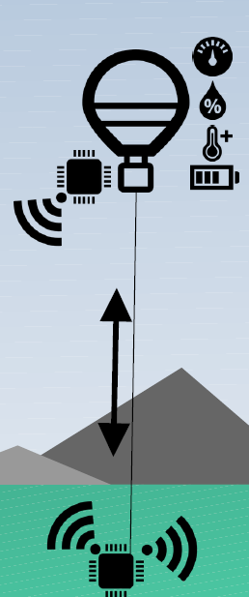

To Do List
Worked on an display over SPI
Showing the ballons data at the base station
Modular construction
Maybe showing pictures from the ballon
Maybe be able to change settings with Buttons/Touch of the ballon
Let a human interact from Basestation with one/Multiply ballons
Works like a telephone box but for messages.
„Need help!“
„We´re fine“
…
Temp:
-3°C
Hum:
34%
Batt:
59%
State:
Need help!

Slide 3

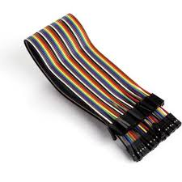
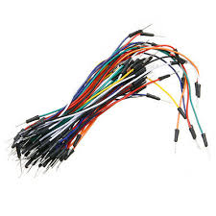

Problem
Cables must be seperated

